Slide 1
English Novel Summarization and Visualizations
App-solutely Mobile
Fatemeh Pesaran Zadeh, Sehee Kim

Slide 2
Contents
Introduction
Methodology
Results
Conclusion
Project Management

Slide 3
Introduction

Slide 4
Motivation
More people are studying foreign languages
Studying foreign languages with visual aids are effective
We provide a way for visual aids to be more accessible
Cost-effective
Less time-consuming

Slide 5
Proposed Idea & Approach
Proposed Idea: Provide illustrations for English novels
Up to midterm presentation
Stories → Text Summarization → Text-to-Image Generation → Illustrations
Current approach
Focused on visualizing the main character
Main character’s appearance is a key factor when illustrating story
It should not change during in between illustrations → Find all information and create it first
Named Entity Recognition
Named Character Detail Extraction
Main Character Visualization
User Interface
Character Description

Slide 6
Novelty
Addition of the user interface
A console is provided so that the user has a chance to modify the caption after it is provided
Does not solely rely on the accuracy of the models
Ensures that the captions and the illustrations stay true to the original text

Slide 7
Methodology

Slide 8
Character Description - Named Entity Recognition
Find main character within story → Extract description of main character
Named Entity Recognition
Find main character
Fine-tuned Bert model for Named Entity Recognition

Slide 9
Character Description - Main Character Detail Extraction
Question Anwering
Extract details about the appearance of main character
Questions:
"Can you describe the main character’s appearance?"
"Tell me about the main character’s physical features."
"What are the distinguishing characteristics of the main character?"’
Prompts to guide the question-answering model → extract relevant information
Gathered information → Concise sentence → Caption

Slide 10
Main Character Visualization
Used “prompt to prompt image editing with cross attention map” paper approach:
Enhanced Image Generation: The diffusion model enables precise editing of generated images for visually appealing results.
Flexibility and Adaptability: Easy modification of prompts allows fine-grained control over image generation.
Coherence and Consistency: Cross attention maps ensure visual continuity and coherence between prompts and images.
Seamless Integration: The approach seamlessly integrates textual prompts with image generation for a cohesive connection.
Creative Expression: The technique provides a unique and creative way to visually express the main character's attributes and story.
Notes:
1. Enhanced Image Generation: The diffusion model enables precise editing of generated images for visually appealing results.
2. Flexibility and Adaptability: Easy modification of prompts allows fine-grained control over image generation.
3. Coherence and Consistency: Cross attention maps ensure visual continuity and coherence between prompts and images.
4. Contextual Understanding: The model captures and leverages contextual information from prompts for contextually relevant images.
5. Seamless Integration: The approach seamlessly integrates textual prompts with image generation for a cohesive connection.
6. Creative Expression: The technique provides a unique and creative way to visually express the main character's attributes and story.
7. State-of-the-Art Performance: The paper introduces cutting-edge techniques for generating high-quality images aligned with prompts.

Slide 11
User Interface
Information from question answering may not be totally accurate.
Human involvement to complement information
Receive caption and created image → Caption modification from user → Send modified caption back to cloud
Device
Cloud
Image, caption
Modified caption

Slide 12
Results

Slide 13

Visualization based on generated caption.
“Cinderella is Beautiful Kind-hearted, gentle, and hardworking”

Slide 14
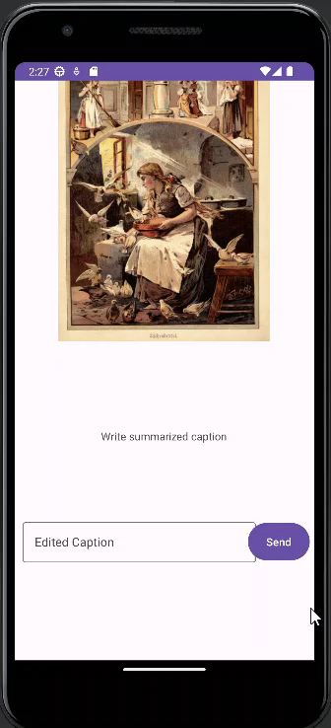
User Interface
Designed for use in mobile device
Original Plan: Connect to cloud and move data back and forth between cloud and device
Current implementation: on device only, video only design, not actual captions or image

Slide 15
Evaluation Results
Since there is practically no way for quantitative evaluations on this topic, we had to use qualitative methods for evaluation.
Extraction of physical description:
Adequate
Does not only extract the exact part
Visualization:
Captures the main character
Low resolution images

Slide 16
Challenges
Time management
We spent a lot of time on several cases of trial and error
Tried different methods such as various models and prompts
Changes in team members
Decrease in team members during the progress of the project
Difficult to divide the workload

Slide 17
Conclusion

Slide 18
Conclusion
Goal: Provide enhanced language learning experience
Tasks: Named Entity Recognition, Text Summarization, and Image Generation
User Console: Improve accuracy
Limitations:
Time constraints
Generate only first caption, implement only the design of the console
Diffusion model
Not fine-tuned on images related to story illustrations
Future work
Address limitations

Slide 19
Project Management

Slide 20
Project Management
Scope of the project
Before midterm: Focus on building an acceptable text summarization model for story summarization in order to create captions
Current: Added user involvement to complement inaccuracies
Our main task is not text summarization
Roles and contributions: Not strictly separated
 | Up to Midterm | Up to Final
Fatemeh | Idea, experimenting on image generation using summaries | Final model development(name entity recognition,extracting features, image generating), Paper
Sehee | Idea, Text summarization experiment, Presentation | Mobile console development, Presentation

Slide 21
Project Management
Timeline
Text Summarization
Midterm
Console Development
Final
Visualization Experiments
Final Model Development
Meeting with Professor

Slide 22
Project Management
Timeline
Text Summarization
Midterm
Console Development
Final
Visualization Experiments
Final Model Development
Meeting with Professor

Slide 23
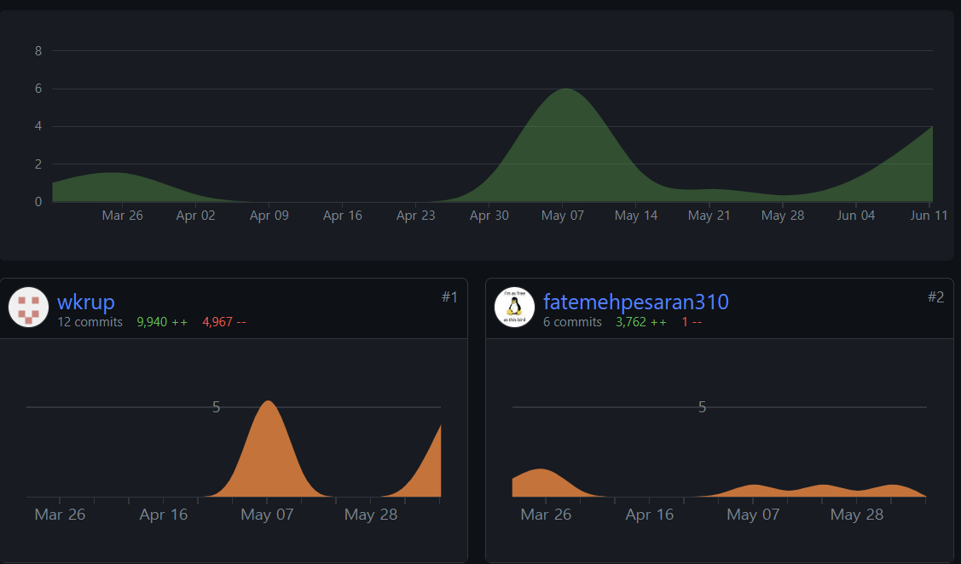
Project Management
Git usage stats: Contributions to main

Slide 24
Lessons and Reflections
Time Management
We focused too much on experimentation and spent too much time on this part
Needed firmer restrictions on designated schedules
Preparation for the unexpected
Many unexpected events occurred that threw us off track

Slide 25
Thank You for Listening

